Slide 1
IMAGE SEGMENTATION By, Ashis Pradhan (CSE Department, SMIT)

Slide 2
What is Segmentation?
Different approaches for Image segmentation
Discontinuity based
Region Based (Similarity)
Detection of point, line and edge
Thresholding
Region Growing
Clustering Algorithm (K-Means)

Slide 3
Preview
Segmentation is to subdivide an image into its constituent component or objects.
The purpose of this operation is to further analyze these constituent object to extract some information which can be used for high level applications.
The level of detail to which the subdivision is carried depends on the problem being solved.
Segmentation stops when object of interest in an application have been detected.
(Eg. No. of Vehicle surveillance on a particular road)

Slide 4
Image Segmentation
Discontinuity Similarity
Based Based
Partition an Image based on abrupt changes in gray levels | Partition an Image based on similar properties or region based.
Detection of isolated points Lines Edges | Thresholding Region Growing Region Splitting & Merging

Slide 5
Principal approaches
Segmentation algorithms generally are based on one of 2 basic properties of intensity values:
Discontinuity: to partition an image based on sharp changes in intensity (e.g. edges)
Similarity: to partition an image into regions that are similar according to a set of predefined criteria. (e.g. Thresholding, region growing)

Slide 6
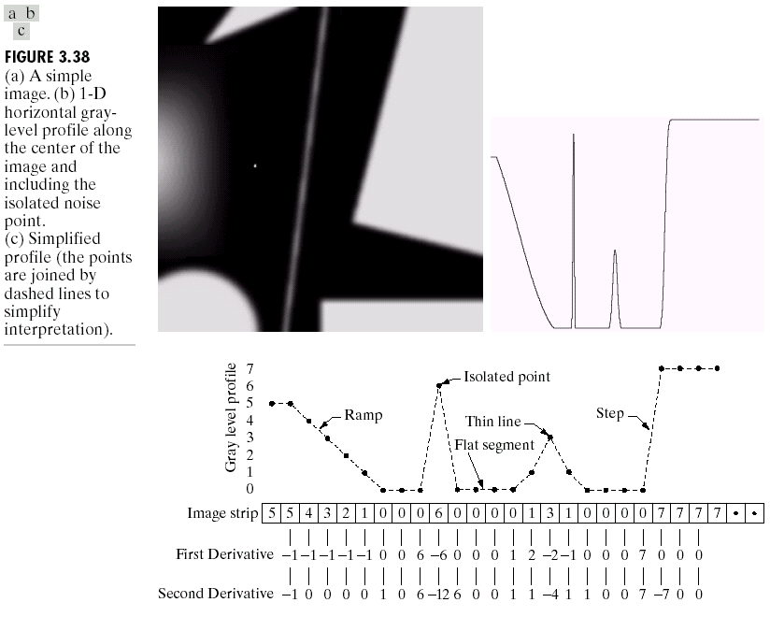
Sharpening Spatial Filters

Slide 7
Detection Of Discontinuities
There are three basic types of grey level discontinuities that we tend to look for in digital images:
Points, Lines, Edges
Edge pixels are pixels at which the intensity of an image function changes abruptly.
Edges (or edge segments) are set of connected edge pixels.
Edge detector are local image processing methods designed to detect edge pixels.
A line is an edge segment whose intensity of background on either side of line is either much higher or much lower than intensity of line pixel

Slide 8
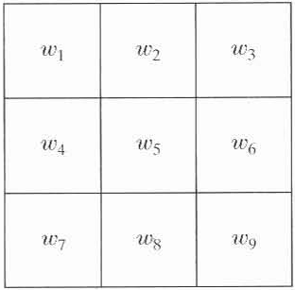
The approach used to identify discontinuities in a image is to run a mask over the the image.
We say that a point, line, and edge has been detected at the location on which the mask is centered:
if ,where

Slide 9
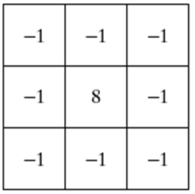
Detection of isolated points
Point detection can be achieved simply using the mask below:
Points are detected at those pixels in the subsequent filtered image that are above a set threshold

Slide 10
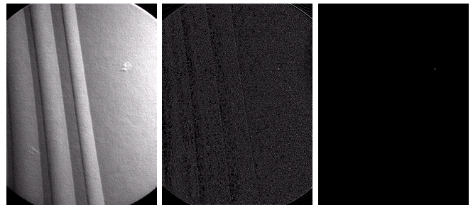
X-ray image of a turbine blade
Result of point detection
Result of thresholding

Slide 11
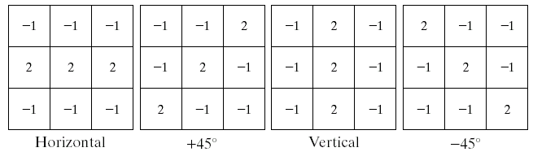
Line Detection
The masks below will extract lines that are one pixel thick and running in a particular direction

Slide 12
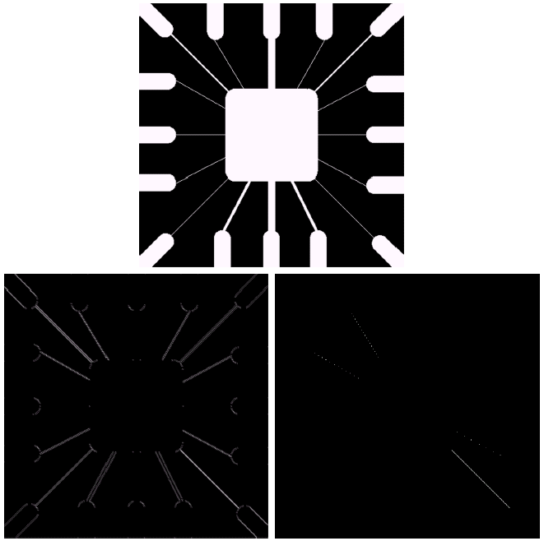
Binary image of a wire bond mask
After processing with -45° line detector
Result of thresholding filtering result

Slide 13
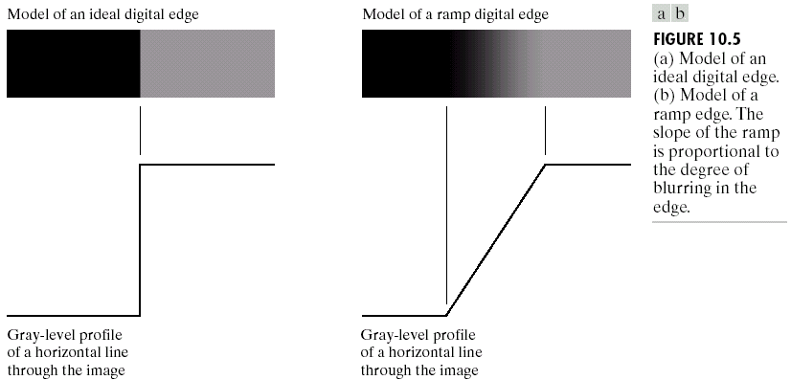
EDGE
An edge is a set of connected pixels that lie on the boundary between two regions

Slide 14
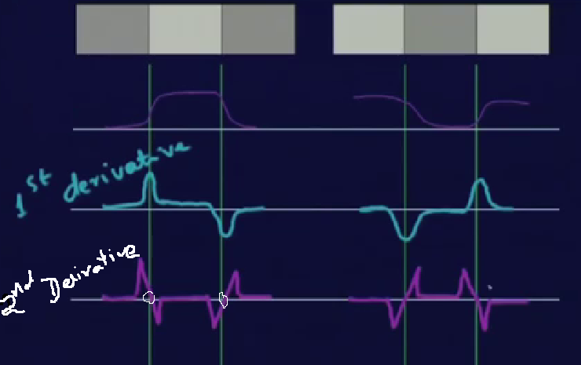
Edge Detection

Slide 15
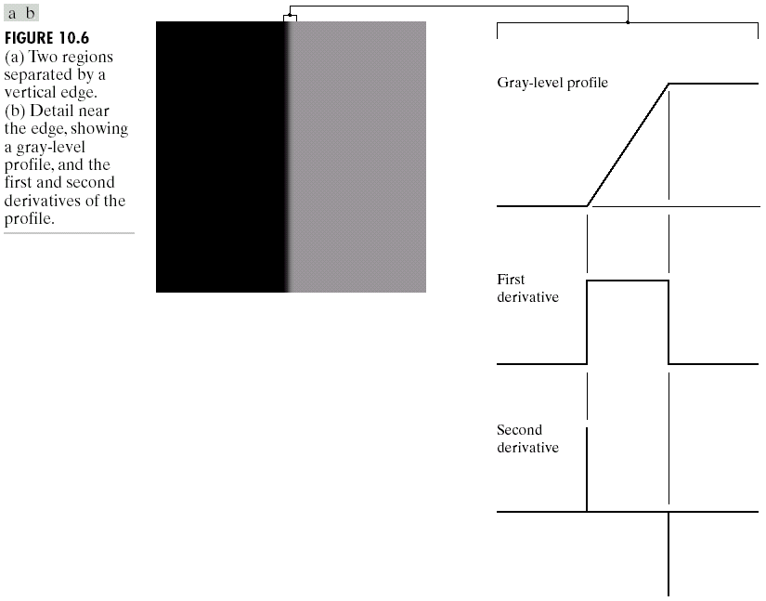
Basic idea: computation of a local derivative operator.
We have already spoken about how derivatives are used to find discontinuities:
1st derivative tells us where an edge is
2nd derivative can be used to show edge direction

Slide 16
Edge Detection
• The magnitude of the first derivative can be used to detect an edge
• The sign (zero crossing) of the second derivative can be used to detect an edge.
• The same idea can be extended into 2-D. 2-D derivatives should be used.
• The magnitude of the gradient and sign of the Laplacian are used.

Slide 17
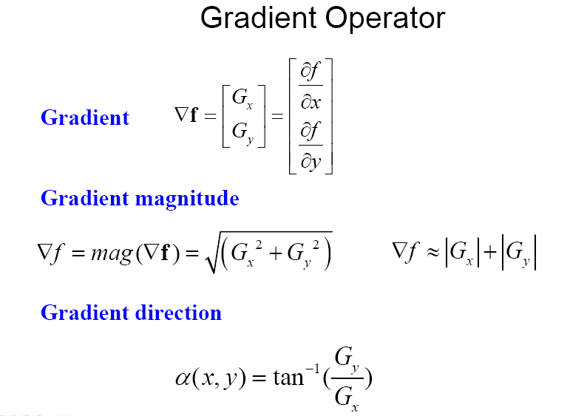
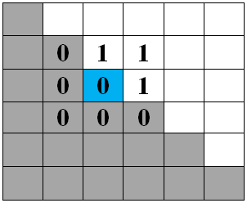

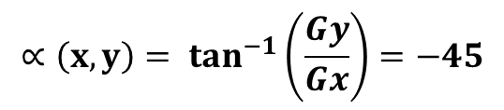
Basic Edge Detection
Left Right
y
Bottom Top
Edge
Direction
x
Gx = top – bottom= -2
Gx = right – left= 2
Mag(x,y)= 2 $\sqrt{2}$
$${∝\left(x,y\right)= tan}^{−1}\left(\frac{Gy}{Gx}\right)=−45$$
Edge direction= 135 - 90
= 45
NOTE: Direction of Edge is always orthogonal to direction of Gradient

Slide 18
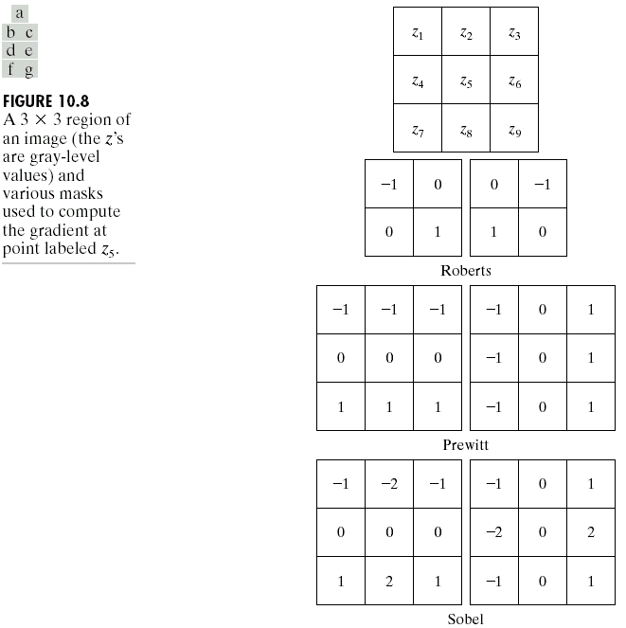
Common Edge Detecting Operator
Given a 3*3 region of an image the following edge detection filters can be used

Slide 19
Robert
Gx= z9 - z5; Gy= z8 – z6;
Prewitt
Gx= (z7+z8+z9) - (z1+z2+z3);
Gy= (z3+z6+z9) - (z1+z4+z7);
Sobel
Gx= (z7+2z8+z9) - (z1+2z2+z3);
Gy= (z3+2z6+z9) - (z1+2z4+z7);

Slide 20
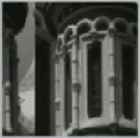
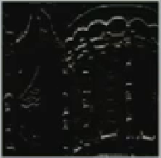
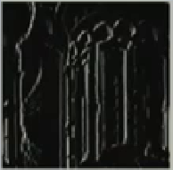
Results
Original Image
Horizontal
Vertical

Slide 21
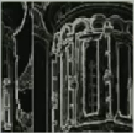
Horizontal
Vertical
Original
Combined

Slide 22
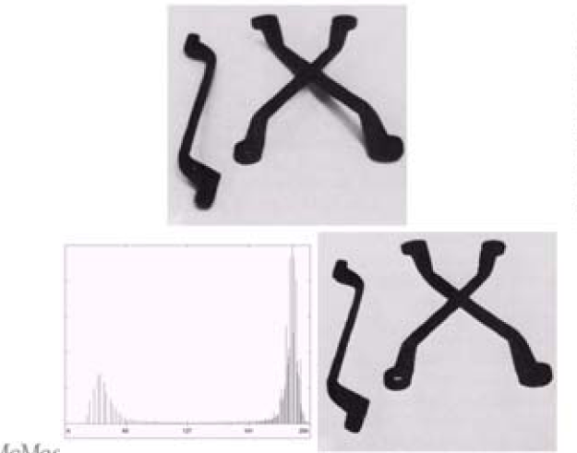
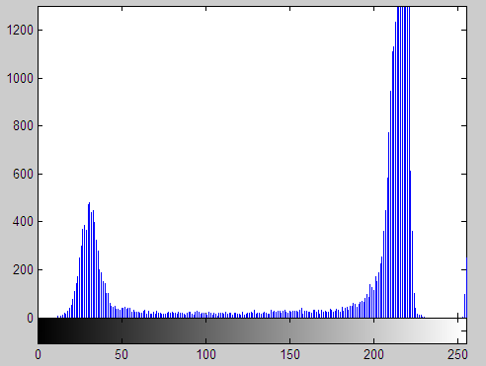
Thresholding
Thresholding is one of the most important approaches to image segmentation that partition the image into regions based on intensity value or properties of these values.
• Gray level histogram of an image f(x,y) composed of a light object on a dark background or vice-versa.
• To extract the object: select a threshold T that separates the gray levels of the background and the object.

Slide 23
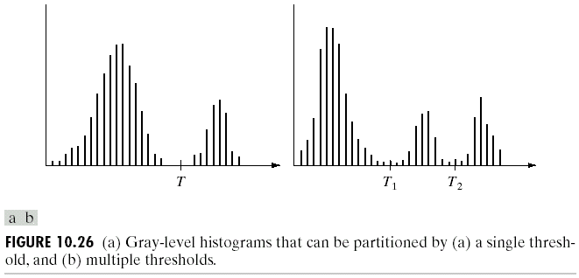
Thresholding
Image with dark background and a light object
Image with dark background and two light object

Slide 24
Single threshold: points with f(x,y)>T belong to object;other points belong to background.
Multiple thresholds: points with f(x,y)>T2 belong to object; points with f(x,y)<T1 belong to bakground.
Multilevel threshold: a point f(x,y) belongs
To an object if T1<f(x,y)<= T2
To another object class if f(x,y)>T2
To background if f(x,y)<=T1
T depends on
Only f(x, y): only on gray level values => Global Threshold
Both f(x, y) and p(x, y) : on gray level values and its neighbors => Local Threshold

Slide 25
Basic Global Thresholding
Select an initial estimate for T
2. Segment the image using T. This will produce two group of pixels G1 (with gray level greater than T) and G2 (with gray level less than T)
3. Compute average gray level values μ1 and μ2 for pixels in regions G1 and G2
4. Compute a new threshold: T=(μ1+ μ2)/2
5. Repeat step 2 through 4 until the difference in T in successive iterations is smaller than a predefined value

Slide 26
Basic Adaptive Thresholding
Subdivide original image into small areas
Utilize a different threshold to segment each sub image
Since the threshold used for each pixel depends on the location of the pixel in terms of sub-images, this type of thresholding is adaptive.

Slide 27
REGION BASED SEGMENTATION
Basic formulation:
Let R represent the entire image region. Segmentation may be viewed as a process that partitions R into subregions, R₁, R₂, … , R_{n}, such that:
Where P(.) is a logical predicate which deals with the properties that must be satisfied by the pixel in a segmented region.

Slide 28
Region Growing
Groups pixels or sub-region into larger regions
Procedure:
Step1: Start with a set of “seed” points
Step2: Selection of suitable properties grow regions by appending to each seed those neighboring pixels that have properties similar to the seed such as specific range of gray level
Step3: Formulation of a stopping criteria.

Slide 29
Criteria
The absolute gray level difference between any pixel and the seed has to be less than 65.
The pixel has to be 8-connected to atleast one pixel in that region(if one or more region are merged)

Slide 30
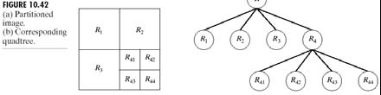
Region Splitting and Merging
• Sub-divide an image into a set of disjoint regions and then merge and/or split the regions in an attempt to satisfy the condition (P).

Slide 31
Procedure:
Split into 4 disjoint quadrants any region Ri where P(Ri)= False.
2. Merge any adjacent regions Rj and Rk for which P(Rj U Rk)= True
3. Stop when no further merging or splitting is possible.

Slide 32
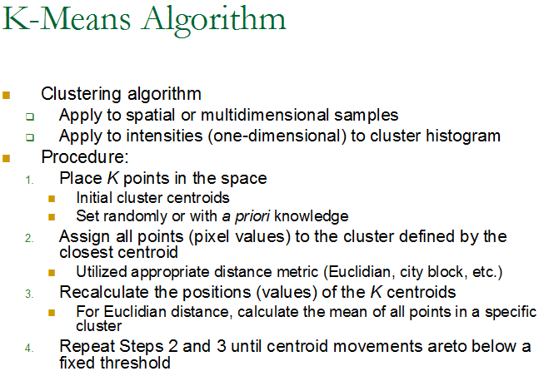

Slide 33
